Slide 1



EMPLOYMENT IN INDIA FOR THE LAST 10 YEARS
Subject:- Managerial Economics
Presented By:-
Anoushka Pandey
Aditi Narayan
Lavisha Maheshwari
Raj Mistry
Dev Modi
Ayush Dani
Mohit Sah
Batch:- Bill Gates 2024

Slide 2
SECTOR-WISE EMPLOYMENT IN INDIA
In India, the Agricultural Sector is the largest employer, engaging around 42% of the workforce, primarily in rural areas through farming, livestock, forestry, and fishing, with a high level of informal employment.
The Industrial Sector employs about 26% of the workforce, with key sub-sectors including manufacturing, mining, construction, and utilities, and major employment hubs in states like Maharashtra, Gujarat, Tamil Nadu, and Karnataka, driven by industries such as automotive, textiles, pharmaceuticals, and construction, encompassing both formal and informal employment.
The Service Sector, contributing the most to India's GDP, employs approximately 32% of the workforce in IT services, financial services, real estate, retail, hospitality, healthcare, education, and transportation, with major urban centers like Bangalore, Mumbai, Delhi, Hyderabad, and Pune serving as employment hubs, particularly in rapidly growing fields like IT, e-commerce, and startups.

Slide 3
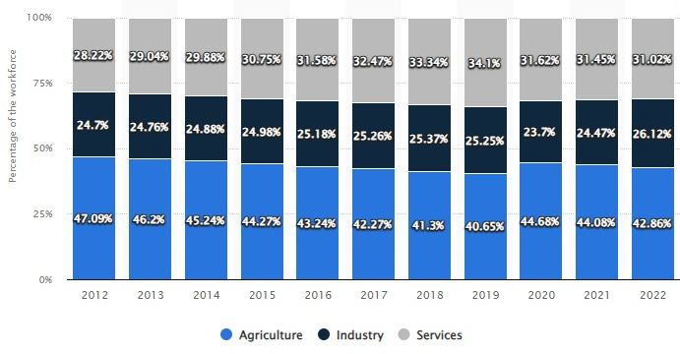
SECTOR-WISE EMPLOYMENT IN INDIA

Slide 4
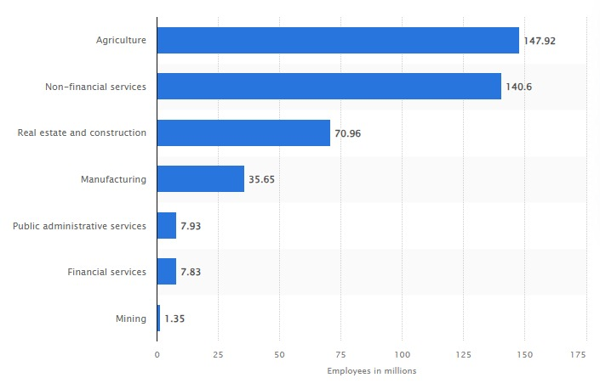
SECTOR-WISE EMPLOYMENT IN INDIA
Sector-wise Employment Data of 2023

Slide 5
STATE-WISE UNEMPLOYMENT DATA
State-Wise Unemployment Data of 2023
STATE | UNEMPLOYMENT RATE (2023)
Andhra Pradesh | 7.70%
Assam | 4.70%
Bihar | 19.10%
Chhattisgarh | 3.40%
Delhi | 20.80%
Goa | 9.90%
Gujarat | 2.30%
Haryana | 37.40%
Himachal Pradesh | 7.60%
Jammu & Kashmir | 14.80%
Jharkhand | 18%
Karnataka | 2.50%
Kerala | 7.40%
Madhya Pradesh | 3.20%
Maharashtra | 3.10%
Meghalaya | 2.70%
Odisha | 0.90%
Puducherry | 4.70%
Punjab | 6.80%
Rajasthan | 28.50%
Sikkim | 13.60%
Tamil Nadu | 4.10%
Telangana | 4.10%
Tripura | 14.30%
Uttar Pradesh | 4.30%
Uttarakhand | 4.20%
West Bengal | 5.50%

Slide 6
STATE-WISE UNEMPLOYMENT DATA
Last 10 years Unemployment Data of India 2011-2021
Year | Unemployment Rate | Percentage Change
2021 | 5.98% | -2.02%
2020 | 8.00% | 2.73%
2019 | 5.27% | -0.06%
2018 | 5.33% | -0.03%
2017 | 5.36% | -0.07%
2016 | 5.42% | -0.01%
2015 | 5.44% | 0.00%
2014 | 5.44% | 0.01%
2013 | 5.42% | 0.01%
2012 | 5.41% | -0.01%
2011 | 5.43% | -0.12%

Slide 7
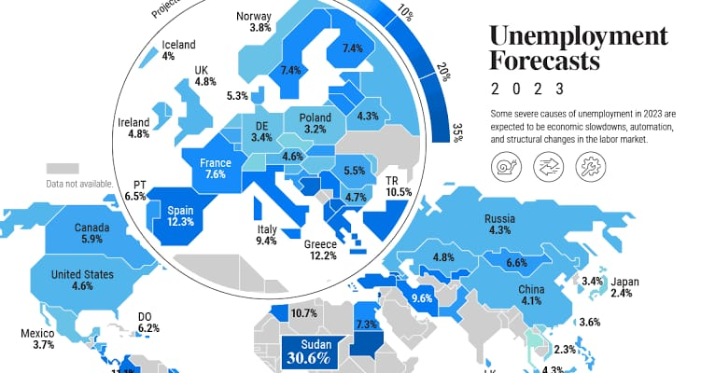
COUNTRY-WISE EMPLOYMENT AND UNEMPLOYMENT
Employment rates show the number of people in paid work as a proportion of the population, broken down by age and sex.
The unemployment rate is the percentage of the labour force that is looking for a job. The labour force is only a portion of the total population.

Slide 8
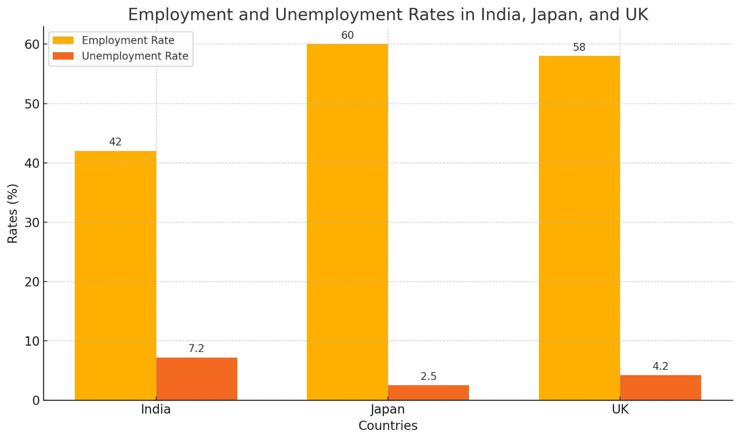
COUNTRY-WISE EMPLOYMENT AND UNEMPLOYMENT
COUNTRYWISE COMPARISION (INDIA, UK, JAPAN)
India (1.428 billion): Employment Rate: 42% Unemployment Rate: 7.2%
Japan (0.068 billion): Employment Rate: 60% Unemployment Rate: 2.5%
UK (0.125 billion): Employment Rate: 58% Unemployment Rate: 4.2%

Slide 9

COUNTRY-WISE EMPLOYMENT AND UNEMPLOYMENT
CONSEQUENCES OF UNEMPLOYMENT
Poverty
Social Problems
Under-Utilization of Resources
CAUSES OF UNEMPLOYMENT
Over Population
Skill Mismatch

Slide 10
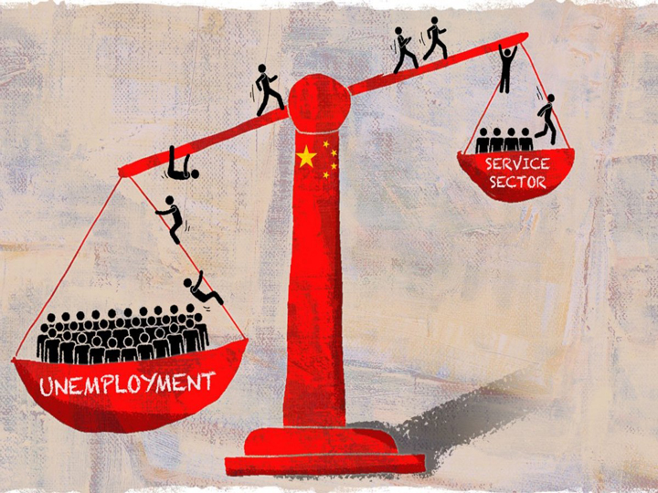
ISSUES IN EMPLOYMENT IN INDIA
Issues In Employment in India
Unemployment and Underemployment
Informal Sector Dominance
Gender Inequality
Rural-Urban Divide
Lack of Quality Education and Skill Development
Slow Growth of Formal Sector Jobs
Impact of Globalization and Technological Advancements

Slide 11

INITIATIVE TAKEN BY THE GOVERNMENT ON EMPLOYMENT
Skill Development and Entrepreneurship
Pradhan Mantri Kaushal Vikas Yojana (PMKVY)
Start-Up India
Atmanirbhar Bharat Rojgar Yojana (ABRY)
Infrastructure Development
Rural Employment
Mahatma Gandhi National Rural Employment Guarantee Act (MGNREGA)
Pradhan Mantri Awaas Yojana (PMAY)

Slide 12
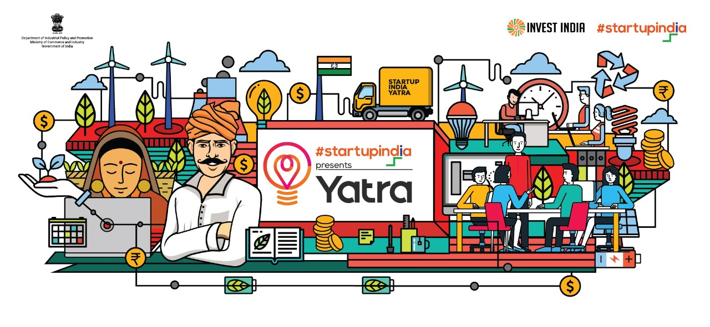
INITIATIVE TAKEN BY THE GOVERNMENT ON EMPLOYMENT
Steps taken by Indian Government
Skill Development Programs (Skill India) Make in India
Rural Employment Schemes (MGNREGA) Startup India
Labour Reform
Invest in Education and Skill Development
Promote Entrepreneurship
Labor Market Reforms
Diversification of the Economy

Slide 13

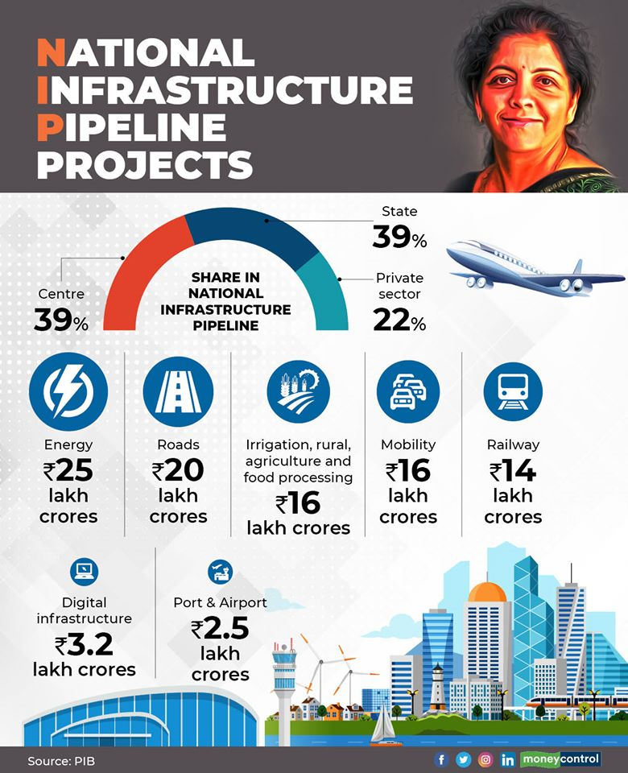



Slide 14
THANK YOU

